Slide 1
Kernelization: The basics
Bart M. P. Jansen
Parameterized Complexity Summer School @ Vienna
September 2nd 2017, Vienna, Austria
Notes:
My first name is Bart, don’t hesitate to use it – you may stop me at any time.

Slide 2
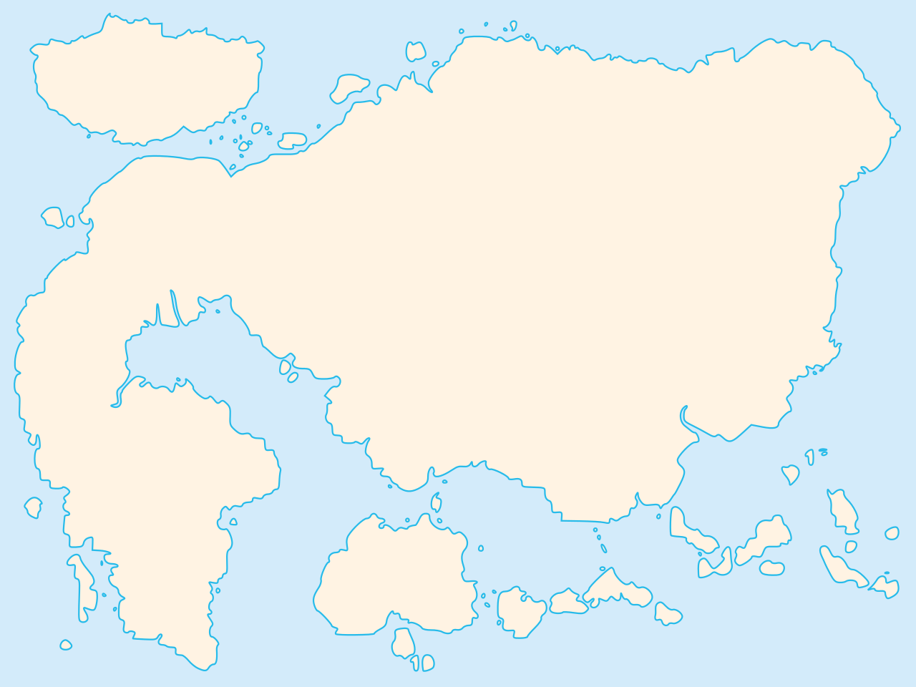
Map of polynomial-time computation
Kernelization
Primality
testing
The lost continent of polynomial time
Network flows
Sorting
Parsing
context-free grammars
Fast Fourier transform
Shortest paths
Longest common
subsequence
Approximation
Islands of
minor-testing
Notes:
The striking realization that there are polynomial-time algorithms that hold provable power over NP-hard problems, without actually solving them.

Slide 3
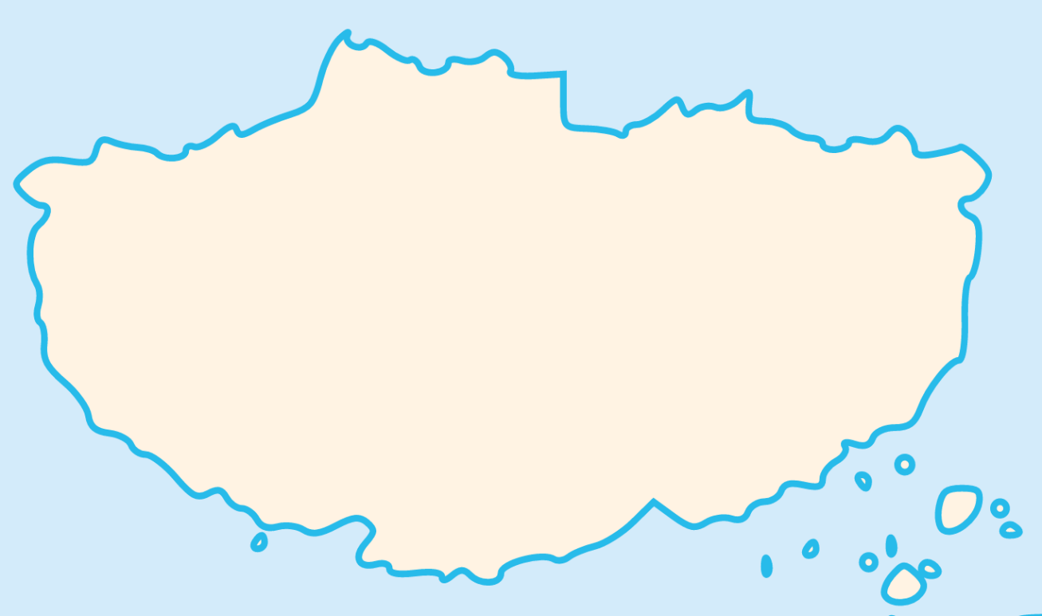
Map of the lost continent
Linear algebra
Crown reduction
Protrusion
reduction
  The lost continent of polynomial time contains:
  provably effective and efficient preprocessing algorithms
  that reduce the sizes of NP-hard inputs
  (without changing the answer)
Representative sets
Concentration
bounds
Expansion lemma
Sunflower lemma
Well-quasi ordering
Notes:
there are polynomial-time algorithms that hold provable power over the solutions to NP-hard problems, without actually finding them

Slide 4



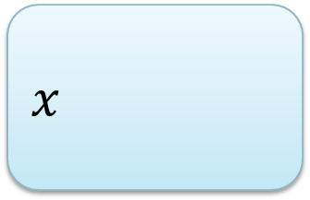
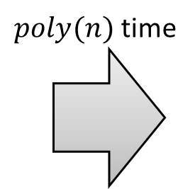



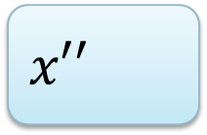
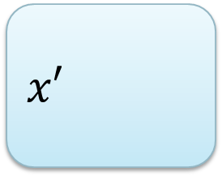


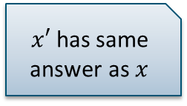

Provable preprocessing
What does provably effective and provably efficient mean?
  Efficient: preprocessing runs in polynomial time
  Effective: shrinks the input without changing the answer
How to guarantee an effective preprocessing algorithm?
$n$ bits
$n−1$ bits
$$x$$
$poly(n)$ time
$$x′$$
$x′$ has same answer as $x$
$n−2$ bits
$$⋯$$
$1$ bit
$$x′′$$
$$x^{∗}$$
$n⋅poly(n)$time

Slide 5
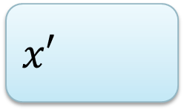
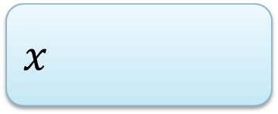
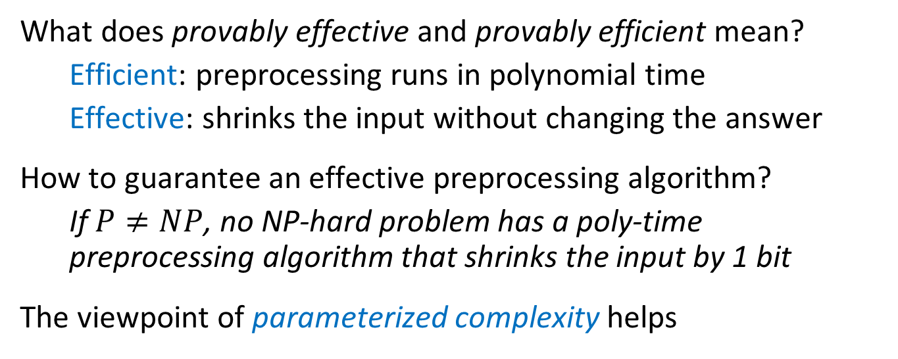
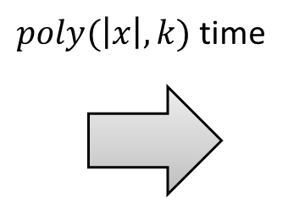




Provable preprocessing
What does provably effective and provably efficient mean?
  Efficient: preprocessing runs in polynomial time
  Effective: shrinks the input without changing the answer
How to guarantee an effective preprocessing algorithm?
  If $P≠NP$, no NP-hard problem has a poly-time preprocessing algorithm that shrinks the input by 1 bit
The viewpoint of parameterized complexity helps
$n$ bits
$f(k)$ bits
$$x$$
$poly(\left|x\right|,k)$ time
$$x′$$
$$k$$
$$k′$$

Slide 6
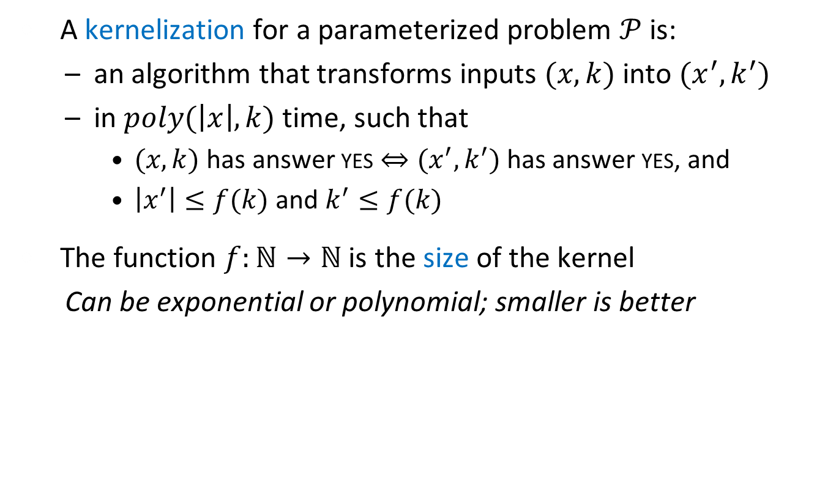
Kernelization: data reduction with a guarantee
A kernelization for a parameterized problem $𝒫$ is:
  an algorithm that transforms inputs $(x,k)$ into $(x^{′},k^{′})$
  in $poly(\left|x\right|,k)$ time, such that
    $(x,k)$ has answer yes $⇔(x^{′},k^{′})$ has answer yes, and
    $\left|x^{′}\right|≤f(k)$ and $k^{′}≤f(k)$
The function $f:ℕ→ℕ$ is the size of the kernel
  Can be exponential or polynomial; smaller is better
  A kernelization guarantees that instances that are large with respect to their complexity parameter can be shrunk
$n$ bits
$f(k)$ bits
$$x$$
$poly(\left|x\right|,k)$ time
$$x′$$
$$k$$
$$k′$$

Slide 7
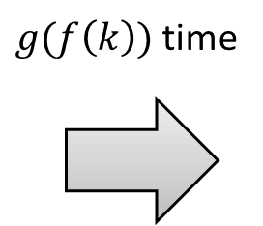
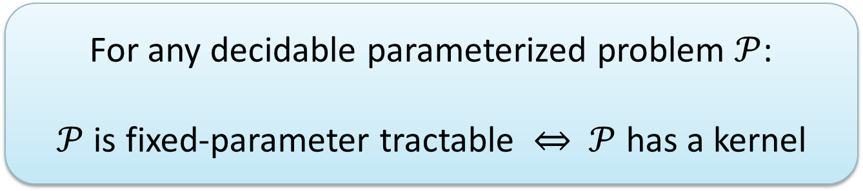
Kernelization & parameterized algorithms
Using any algorithm on the kernel gives an FPT algorithm
For any decidable parameterized problem $𝒫$:
$𝒫$ is fixed-parameter tractable $⇔$ $𝒫$ has a kernel
$n$ bits
$f(k)$ bits
$$x$$
$poly(\left|x\right|,k)$ time
$g(f\left(k\right))$ time
yes/no
$$k$$
$$x′$$
$$k′$$

Slide 8
A kernel for edge clique cover

Slide 9
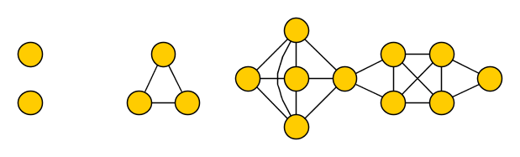
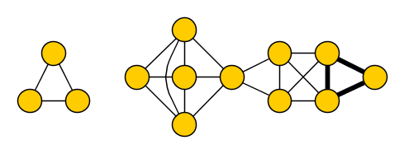
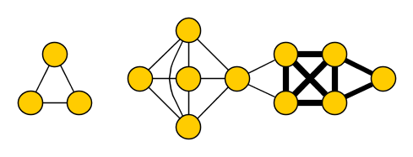
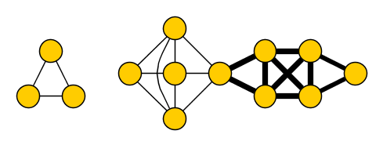
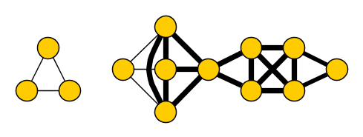
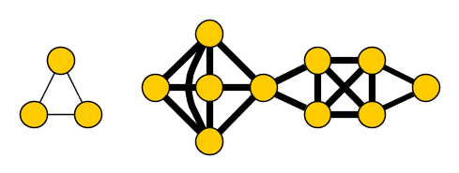
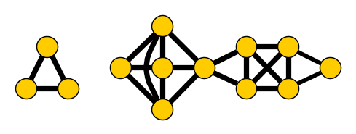
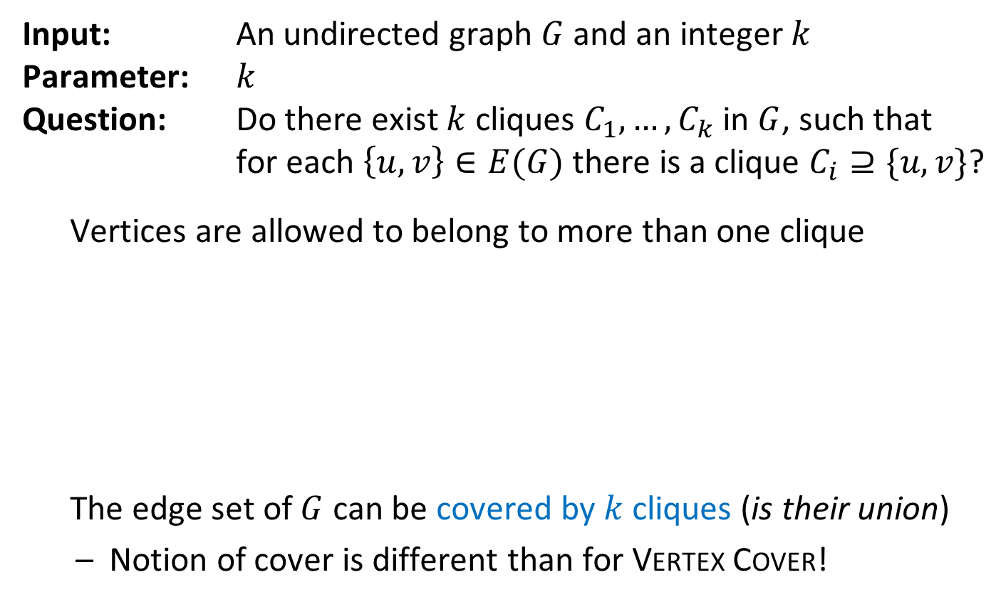

Edge Clique Cover
Input: An undirected graph $G$ and an integer $k$
Parameter: $k$
Question: Do there exist $k$ cliques $C_{1},…, C_{k}$ in $G$, such that for each $\left\{u,v\right\}∈E(G)$ there is a clique $C_{i}⊇\{u,v\}$?
Vertices are allowed to belong to more than one clique
The edge set of $G$ can be covered by $k$ cliques (is their union)
  Notion of cover is different than for Vertex Cover!
yes for $k=6$
Notes:
NP-complete, has applications in finding the smallest representation of the graph as the intersection graph of a system of subsets of a size-k universe.

Slide 10
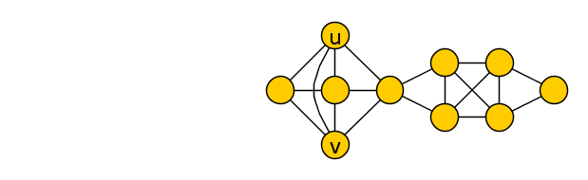
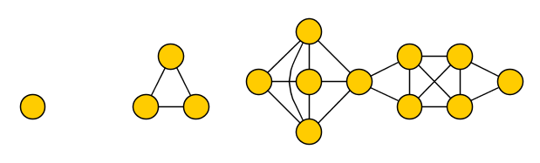
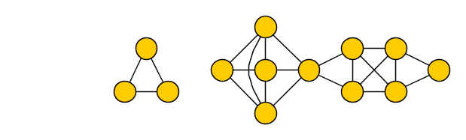
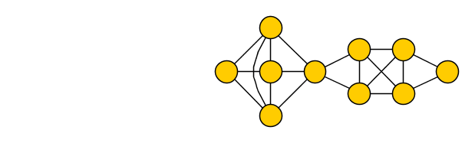
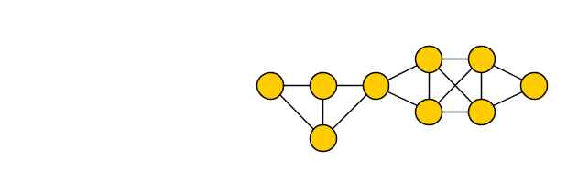
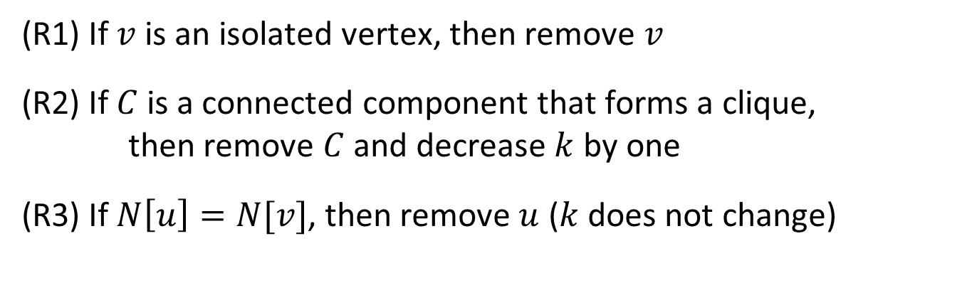
Reduction rules for Edge Clique Cover
(R1) If $v$ is an isolated vertex, then remove $v$
(R2) If $C$ is a connected component that forms a clique,
then remove $C$ and decrease $k$ by one
(R3) If $N\left[u\right]=N[v]$, then remove $u$ ($k$ does not change)
Notes:
For R3: Deleting a vertex does not make the problem harder (remainder of cliques cover remainder of edges). Deleting u does not make the problem easier: vertex u can be added to any clique containing v, to cover all its edges since it has the same neighbors.

Slide 11
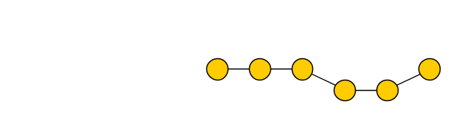
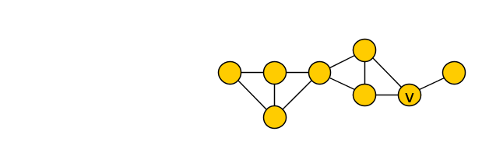
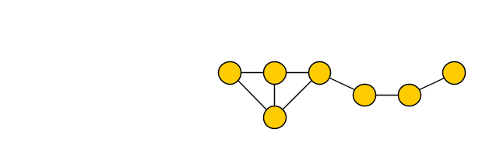

Reduction rules for Edge Clique Cover
(R1) If $v$ is an isolated vertex, then remove $v$
(R2) If $C$ is a connected component that forms a clique,
then remove $C$ and decrease $k$ by one
(R3) If $N\left[u\right]=N[v]$, then remove $u$ ($k$ does not change)
Notes:
Apply them in order.

Slide 12


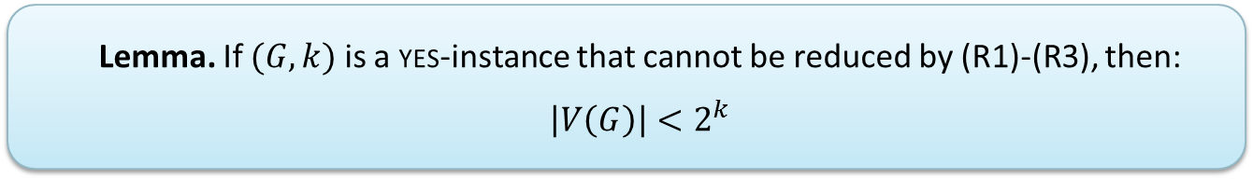
Effectiveness of reduction rules
  Lemma. If $(G,k)$ is a yes-instance that cannot be reduced by (R1)-(R3), then: $\left|V\left(G\right)\right|<2^{k}$
Proof. Fix a solution $C_{1},…, C_{k}$ and assign a bitvector to each vertex
$$vec\left(v\right)≔(v\begin{matrix}? \\ ∈ \\ \end{matrix}C_{1},v\begin{matrix}? \\ ∈ \\ \end{matrix}C_{2},…, v\begin{matrix}? \\ ∈ \\ \end{matrix}C_{k})$$
$$v$$
Notes:
N[u] = vertices occurring in a clique with u = vertices occurring in a clique with v = N[v]

Slide 13

Effectiveness of reduction rules
  Lemma. If $(G,k)$ is a yes-instance that cannot be reduced by (R1)-(R3), then: $\left|V\left(G\right)\right|<2^{k}$
Proof. Fix a solution $C_{1},…, C_{k}$ and assign a bitvector to each vertex
$$vec\left(v\right)≔(1,1, 0,0,0)\begin{matrix} \\ \\ \end{matrix}$$
$$v$$
Notes:
N[u] = vertices occurring in a clique with u = vertices occurring in a clique with v = N[v]

Slide 14

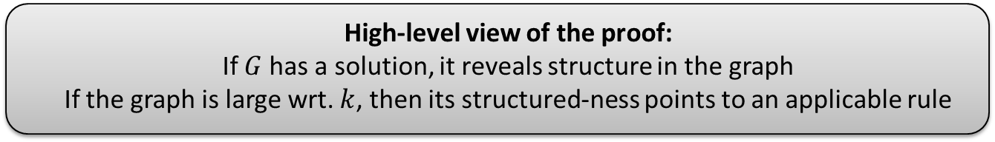
Effectiveness of reduction rules
  Lemma. If $(G,k)$ is a yes-instance that cannot be reduced by (R1)-(R3), then: $\left|V\left(G\right)\right|<2^{k}$
Proof. If $vec\left(v\right)=000…000$: then $v$ is isolated, (R1) applies
If $vec\left(v\right)=vec(u)$: then $N\left[u\right]=N[v]$ and (R2/3) applies
So $\left|V\left(G\right)\right|<$ $|\{$bitvectors of length $k\}|$ = $2^{k}$
  High-level view of the proof:
  If $G$ has a solution, it reveals structure in the graph
  If the graph is large wrt. $k$, then its structured-ness points to an applicable rule
Notes:
N[u] = vertices occurring in a clique with u = vertices occurring in a clique with v = N[v]

Slide 15

Complete kernelization for Edge Clique Cover
Consider input $(G,k)$
Exhaustively apply (R1)-(R3) to obtain $(G^{′},k^{′})$
if $\left|V\left(G^{′}\right)\right|≥2^{k^{′}}$
  then output “$G$ has no solution of size $k$”
  else output $(G^{′},k^{′})$ with less than $2^{k^{′}}$ vertices
This kernelization is essentially the best known
  [Gramm, Guo, Hüffner and Niedermeier, ACM Exper. Alg. 08]
No kernel of bitsize $2^{o\left(k\right)}$ unless P=NP
  [Cygan, Pilipczuk, Pilipczuk, SICOMP’16]

Slide 16
A kernel for vertex cover
Elementary reduction rules

Slide 17
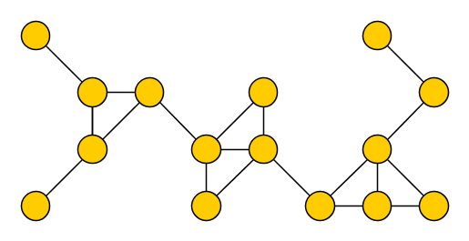
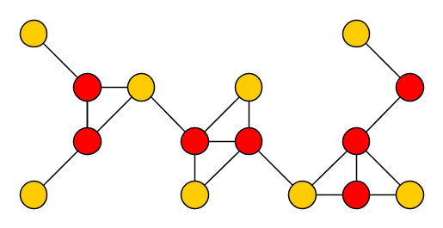

The Vertex Cover problem
Input: An undirected graph $G$ and an integer $k$
Parameter: $k$
Question: Is there a set $S$ of at most $k$ vertices in $G$, such that each edge of $G$ has an endpoint in $S$?
Such a set $S$ is a vertex cover of $G$

Slide 18
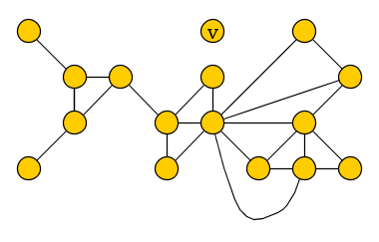
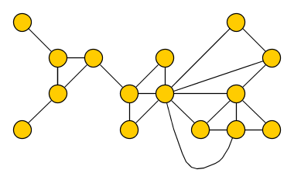

Reduction rules for Vertex Cover – (R1)
(R1) If there is an isolated vertex $v$, delete $v$ from $G$
  Reduce to the instance $\left(G−v,k\right)$
$$(G= , k=7)$$
$$(G′= , k′=7)$$
Notes:
If v is isolated then it covers no edges and is not part of any optimal solution. Conversely, it does not place additional demands on the solution. So forgetting v does not affect the outcome.

Slide 19
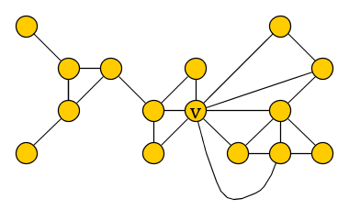
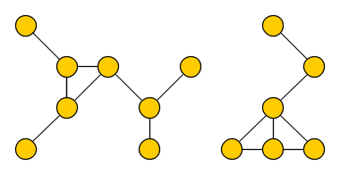


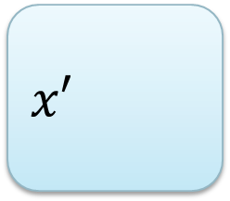
Reduction rules for Vertex Cover – (R2)
(R2) If there is a vertex $v$ of degree more than $k$,
then delete $v$ from $G$ and decrease the parameter by 1
  Reduce to the instance $\left(G−v,k−1\right)$
$$(G= , k=7)$$
$$(G′= , k′=6)$$

Slide 20

Reduction rules for Vertex Cover – (R3)
(R3) If the previous rules are not applicable and $G$ has
more than $k^{2}+k$ vertices or more than $k^{2}$ edges,
then $G$ has no size-$k$ vertex cover and we output answer no

Slide 21
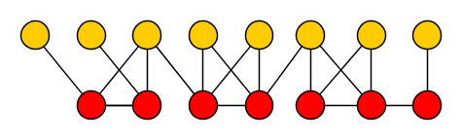


Correctness of the cutoff rule
Lemma. If $G$ is exhaustively reduced under (R1)-(R2) and has more than $k^{2}+k$ vertices or $k^{2}$ edges, then there is no size-$≤k$ vertex cover
Proof.
  Suppose $G$ has a vertex cover $S$
  Since (R1) does not apply, every vertex of $G−S$ has at least one edge
  Since (R2) does not apply, every vertex has degree at most $k$:
  $$\left|E\left(G\right)\right|≤k⋅\left|S\right|$$
  $$\left|V\left(G−S\right)\right|≤\left|E\left(G\right)\right|≤k⋅|S|$$
  So $\left|V\left(G\right)\right|≤\left(k+1\right)⋅|S|$
  So if $G$ has a size-$k$ vertex cover, $\left|V\left(G\right)\right|≤k^{2}+k$ and $\left|E\left(G\right)\right|≤k^{2}$
S

Slide 22


Preprocessing for Vertex Cover
(R1)-(R3) can be exhaustively applied in polynomial time
In polynomial time, we reduce $(G,k)$ to $(G^{′},k^{′})$ such that:
  the two instances are equivalent
  $k^{′}≤k$
  instance $(G^{′},k^{′})$ has at most $k^{2}+k$ vertices and $k^{2}$ edges
Vertex Cover parameterized by solution size $k$
has a kernel with $k^{2}+k$vertices and $k^{2}$ edges

Slide 23

better kernel for vertex cover
Crown reductions

Slide 24





Motivating examples
If $G$ has a degree-1 vertex $u$ with neighbor $v$:
  Exists optimal vertex cover using $v$ and not $u$
  Remove $u$ and $v$ from $G$ to obtain $G′$
  $G$ has vtx-cover of size $k⇔G′$ has vtx-cover of size $k−1$
$$k^{′}≔k−1$$

Slide 25




Motivating examples
If $G$ has non-adjacent vertices $u,u′$ with neighborhood $\{v,v^{′}\}$:
  Exists optimal vertex cover using $\{v,v^{′}\}$ and not $\{u,u^{′}\}$
  Remove $\{u,u^{′},v,v^{′}\}$ from $G$ to obtain $G′$
  $G$ has vtx-cover of size $k⇔G′$ has vtx-cover of size $k−2$
$$k^{′}≔k−2$$
Notes:
Solution S contains at least one vertex of {u,v} and one of {u’,v’} => S \ {u,u’} U {v,v’} is a solution that is not bigger.

Slide 26




Crown decomposition
A crown decomposition of graph $G$ is a partition of $V(G)$ into
Crown $C$
independent set
(non-empty)
Head $H$
matched into $C$
(may contain edges)
Remainder $R$
not adjacent to $C$
$∃$ opt vertex cover containing all of $H$ and none of $C$

Slide 27




Crown reduction for Vertex Cover
$G$ has a vertex cover of size $k$ if and only if
$G−(C∪H)$ has a vertex cover of size $k−|H|$
Off with his head!
Notes:
The name of the concept is so colorful that you cannot help but remember. Combined with the generality and wide applicability of the technique, this led to many applications.

Slide 28

Crown-based kernelization for Vertex Cover
Strategy to kernelize instance $(G,k)$:
  find a crown decomposition $(C,H,R)$ of $V(G)$
  remove $C∪H$ from $G$
  decrease $k$ by $|H|$
  repeat as long as a crown decomposition can be found
1. How can we find a crown decomposition?
2. What can we guarantee when we can no longer find one?

Slide 29


Crown lemma
If graph $G$ has more than $3k$ vertices, then $G$ has
a matching of size $k+1$, or
a crown decomposition,
and one can be found in polynomial time.
If we fail to find a crown decomposition of $G$, then
  $G$ has at most $3k$ vertices and is kernelized, or
  $G$ has a matching of size $k+1$ $⇒$ no size-$k$ vertex cover
To get a kernel with $3k$ vertices, suffices to prove the lemma

Slide 30












Crown lemma
If graph $G$ has more than $3k$ vertices, then $G$ has
a matching of size $k+1$, or
a crown decomposition,
and one can be found in polynomial time.
Greedily find maximal matching $M$
If $\left|M\right|>k$, then (a) holds
If $\left|M\right|≤k$, then $\left|V\left(M\right)\right|≤2k$
  Unmatched vertices $I$ are independent
  Compute maximum matching $M′$
  in bipartite graph $G′$ between $V(M)$ and $I$
    If $\left|M^{′}\right|>k$, then (a) holds
    Else $M′$ leaves a vertex in $I$ unsaturated
      (If $M^{′}$ saturates $I$, then $V\left(G\right)≤3k$)
$$V(M)$$
$$I$$

Slide 31






Crown lemma
If graph $G$ has more than $3k$ vertices, then $G$ has
a matching of size $k+1$, or
a crown decomposition,
and one can be found in polynomial time.
Else $M′$ leaves a vertex in $I$ unsaturated
  $D ≔$ vertices reachable in $G′$ from an unsat. $I$-vertex by an $M′$-alternating path
This gives a crown decomposition:
  Crown: $D∩I$ [non-empty, independent]
  Head: $D∩V(M)$ [matched into crown]
  Remainder: $V\left(G\right)∖D$ [not adjacent to crown]
$$V(M)$$
$$I$$
Vertex Cover parameterized by solution size $k$
has a kernel with $3k$ vertices and $O\left(k^{2}\right)$ edges

Slide 32

reductions
WG ‘04
Vertex Cover
Saving $k$ Colors
Saving 𝑘 Colors
Max CNF-SAT
Longest Cycle/Path
$P_{2}$-Packing
𝑃_2-Packing
Hitting Set
$k$-Internal spanning tree
𝑘-Internal spanning tree
Treewidth
Set Packing
Star packing
Triangle packing
Disjoint Cycles
Notes:
Applicable to many problems!

Slide 33



Open problems for Vertex Cover kernelization
Current-best kernel has $2k$ vertices [Nemhauser&Trotter’75]
Current-best runtime for a $O(k)$-vertex kernel is $Ω(n+m+k^{3})$
Does Vertex Cover have a kernel with $\left(2−ε\right)k$ vertices, for any $ε>0$?
Does Vertex Cover have a kernel with $O(k)$ vertices that can be computed in $O(n+m)$ time?

Slide 34
A kernelization for hitting set
The sunflower lemma

Slide 35

















The $d$-Hitting Set problem
Input: Set $U$, integer $k$, and a collection $ℱ=F_{1},…, F_{m}$
of subsets of $U$ that have size exactly $d$
Question: $∃S⊆U$ with $\left|S\right|≤k$ and $S∩F_{i}≠∅$ for all $i∈[m]$?
$$x$$
$$y$$
$$g$$
$$i$$
$$U$$
$$f$$
$$e$$
$$h$$
$$c$$
$$z$$
$$j$$
$$b$$
$$a$$
$$d$$
$S=\left\{b,c,y\right\}$ is a hitting set
Notes:
Without the restriction to sets of size at most d, the problem is W[2]-complete and believed not to be fixed-parameter tractable. Note that 2-hitting set = vertex cover.

Slide 36

The $d$-Hitting Set problem
The case $d=2$ corresponds to Vertex Cover
Can express Dominating Set in graphs of max degree $d−1$
  W[2]-complete without the restriction to size-$d$ sets
$$x$$
$$y$$
$$g$$
$$i$$
$$U$$
$$f$$
$$e$$
$$h$$
$$c$$
$$z$$
$$j$$
$$b$$
$$a$$
$$d$$
$S=\left\{b,c,y\right\}$ is a hitting set

Slide 37













Sunflowers
A sunflower with core $C$ is a collection of sets $F_{1},…, F_{ℓ}$ with:
  $F_{i}∩F_{j}=C$ for all distinct $i,j∈[m]$
  $F_{i}∖C≠∅$ for all $i∈[m]$
The sets $F_{i}∖C$ are the petals, they are pairwise disjoint
$C$ is allowed to be empty
$$a$$
$$z$$
$$h$$
$$C=\{p,q,r\}$$
$$x$$
$$r$$
$$p$$
$$q$$
$$g$$
$$t$$
$$s$$
$$w$$

Slide 38
















Sunflower reduction rule for $d$-Hitting Set
If $ℱ$ has a sunflower $F_{1},…, F_{k+2}$ with core $C$ and $k+2$ petals:
  Reduce to $ℱ^{′}≔ℱ∖\{F_{k+2}\}$
If $S$ is a hitting set of size at most $k$ for $ℱ′$:
  The petals $F_{1}∖C, …, F_{k+1}∖C$ are disjoint
  Since $S$ hits $F_{1},…, F_{k+1}$ with $k$ vertices: $S∩C≠∅$
  Hence $S∩F_{k+2}≠∅$
$$F_{1}$$
$$F_{k+2}$$
$$F_{2}$$
$$F_{k+1}$$
$$F_{3}$$
$$F_{k}$$
$$C$$
$$F_{4}$$
$$…$$
$$F_{5}$$
$$F_{8}$$
$$F_{7}$$
$$F_{6}$$

Slide 39

Sunflower reduction rule for $d$-Hitting Set
If $ℱ$ has a sunflower $F_{1},…, F_{k+2}$ with core $C$ and $k+2$ petals:
  Reduce to $ℱ^{′}≔ℱ∖\{F_{k+2}\}$
If $S$ is a hitting set of size at most $k$ for $ℱ′$, then it also hits $ℱ$
If $S$ is a hitting set of size at most $k$ for $ℱ$, then it also hits $ℱ^{′}$
$$F_{1}$$
$$F_{k+2}$$
$$F_{2}$$
$$F_{k+1}$$
$$F_{3}$$
$$F_{k}$$
$$C$$
$$F_{4}$$
$$…$$
$$F_{5}$$
$$F_{8}$$
$$F_{7}$$
$$F_{6}$$

Slide 40


Kernelization strategy for $d$-Hitting Set
While there is a sunflower $F_{1},…, F_{k+2}$ with $k+2$ petals:
  Remove $F_{k+2}$ from the collection of sets that must be hit
1. How can we find a sunflower with $k+2$ petals?
1. How can we find a sunflower with 𝑘+2 petals?
2. What can we guarantee when we can no longer find one?

Slide 41


Finding sunflowers
Let $ℱ$ be a collection of sets of size exactly $d$
If the reduction rule cannot be applied, we have:
$$|ℱ|≤d!{\left(k+1\right)}^{d}=O\left(k^{d}\right)$$
Threshold is independent of the universe size
Sunflower lemma. If $\left|ℱ\right|>$ $d!{\left(k+1\right)}^{d}$,
then $ℱ$ contains a sunflower with $k+2$ petals.
It can be found in polynomial time.
Notes:
It has a very elegant proof by induction; try it yourself.

Slide 42



Kernel for $d$-Hitting Set
Sunflower rule ensures $|ℱ|≤O(k^{d})$
Remove elements from $U$ that do not occur in any set in $ℱ$
  Ensures $\left|U\right|≤d⋅\left|ℱ\right|=O\left(k^{d}\right)$
Extends to a kernel for setting where
  each set in $ℱ$ has size at most $d$ instead of exactly $d$
$d$-Hitting Set has a kernel with $O\left(k^{d}\right)$ sets and elements

Slide 43


Open problem for Hitting Set kernelization
Current-best kernel has $O(k^{d−1})$ elements and $O\left(k^{d}\right)$ sets
[Abu-Khzam, JCSS’10]
Does $d$-Hitting Set have a kernel with $f(d)k$ elements?

Slide 44
Wrap-up

Slide 45
Mindsets when developing kernels
Reduction-rule first
Try to come up with provably safe reduction rules
Analyze what a large irreducible instance looks like
Structure first
Investigate what a large instance looks like to which the answer is not obviously yes or obviously no
Develop reduction rules to attack the `large parts’
Extremal structure of minimal obstructions
For graph problems that become easier for subgraphs
How large can a graph $G$ be in terms of $k$, when
$(G,k)$ is no but all subgraphs $(G^{′}⊆G,k)$ yield yes?
How large can a graph 𝐺 be in terms of 𝑘, when
(𝐺,𝑘) is no but all subgraphs (𝐺^′⊆𝐺,𝑘) yield yes?

Slide 46


One more open problem
Consider a linear ordering of the vertex set of a graph $G$
The imbalance $σ(v)$ of a vertex $v$ is the absolute value of:
|$N\left(v\right)∩\{vtces before v\}$|-|$N\left(v\right)∩\{vertices after v\}|$
The imbalance of the linear ordering is $\sum_{v∈V\left(G\right)}{σ(v)}$
Imbalance asks: does $G$ have an ordering of imbalance $≤k$?
Does Imbalance have a polynomial kernel?
http://fptschool.mimuw.edu.pl/opl.pdf

Slide 47


Exercises
Build an elementary kernel for Cluster Editing [Ex. 2.5]
Build an exponential kernel for Connected Vertex Cover [Ex. 2.14]
Build a kernel for Dual Coloring using crowns [Ex. 2.22]
Build a kernel for $d$-Set Packing using sunflowers [Ex. 2.29]
Prove the sunflower lemma using induction on $d$
Hint: Use a greedy packing of disjoint sets [Thm. 2.25]
References to Parameterized Algorithms by Cygan et al.
http://link.springer.com/book/10.1007%2F978-3-319-21275-3

Slide 48


Summary
Several kernelizations using interesting combinatorial insights:
Kernelization enables a rigorous scientific study of preprocessing
&
forms a route to fixed-parameter tractable algorithms
Edge Clique Cover
$d$-Hitting Set
𝑑-Hitting Set
Vertex Cover
THANK YOU!
Notes:
More kernels in the next 3 lectures today, and in tomorrow’s lecture by Fahad.

